Slide 1
What do we know about erosion?
KWL or Graphic Organizer
Use pictures to trigger conversation.

Slide 2
5th grade Standards
Science Standard 2 Objective 1 or 3: 1- Describe how weathering and erosion change Earth’s surface or 3-Relate the building up and breaking down of Earth’s surface over time to the various physical land features
Math Standard 5MD Measurements and Data
Writing Standard W5.2 Write and convey ideas informative explanation, W5.7 Short research project using several sources, W5.9 Evidence from informational text to support research
Reading Standard RI 5.10 Comprehend informational text from technical text
Speaking and Listening 5.1d review the key ideas expressed and draw conclusions in light of information and knowledge gained from the discussion.
Technology/Engineering Understand societal issues related to technology, use critical thinking to plan and make informed decisions and solve problems
Social Studies Standard IV Objective 2 Indicator A Describe the impact of physical geography on the cultures of northern and southern regions (industrial resources, agriculture, and climate)

Slide 3
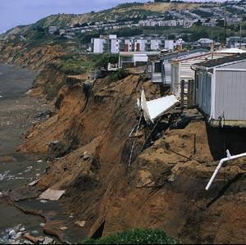
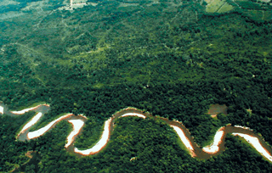
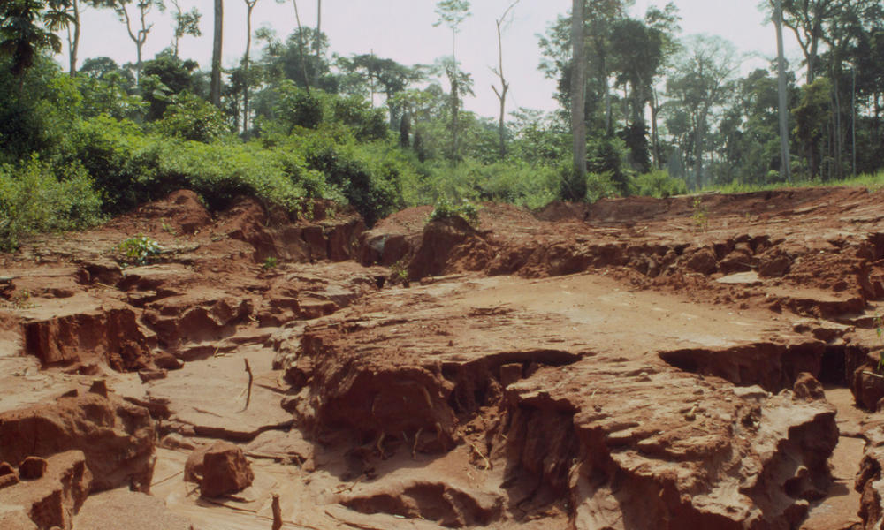
Notes:
http://www.aegweb.org/students-educators/student-resources/aeg-for-students/geologic-hazards/erosion
http://worldwildlife.org/photos/soil-erosion-in-central-african-republic

Slide 4
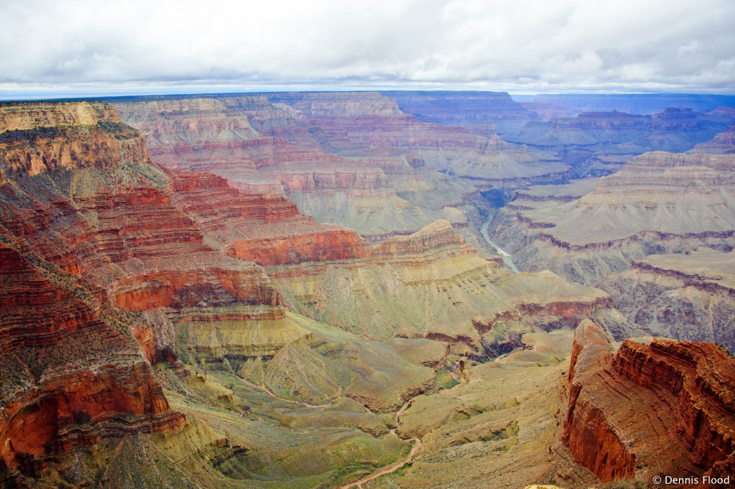
Notes:
http://www.dennisflood.com/photos/get/2a55/signs_of_erosion
Signs of Erosion
The Colorado River has done an amazing job of carving out the Grand Canyon. Beautiful rocks, ridges, cliffs, valleys and of course the river at the bottom of it all.

Slide 5
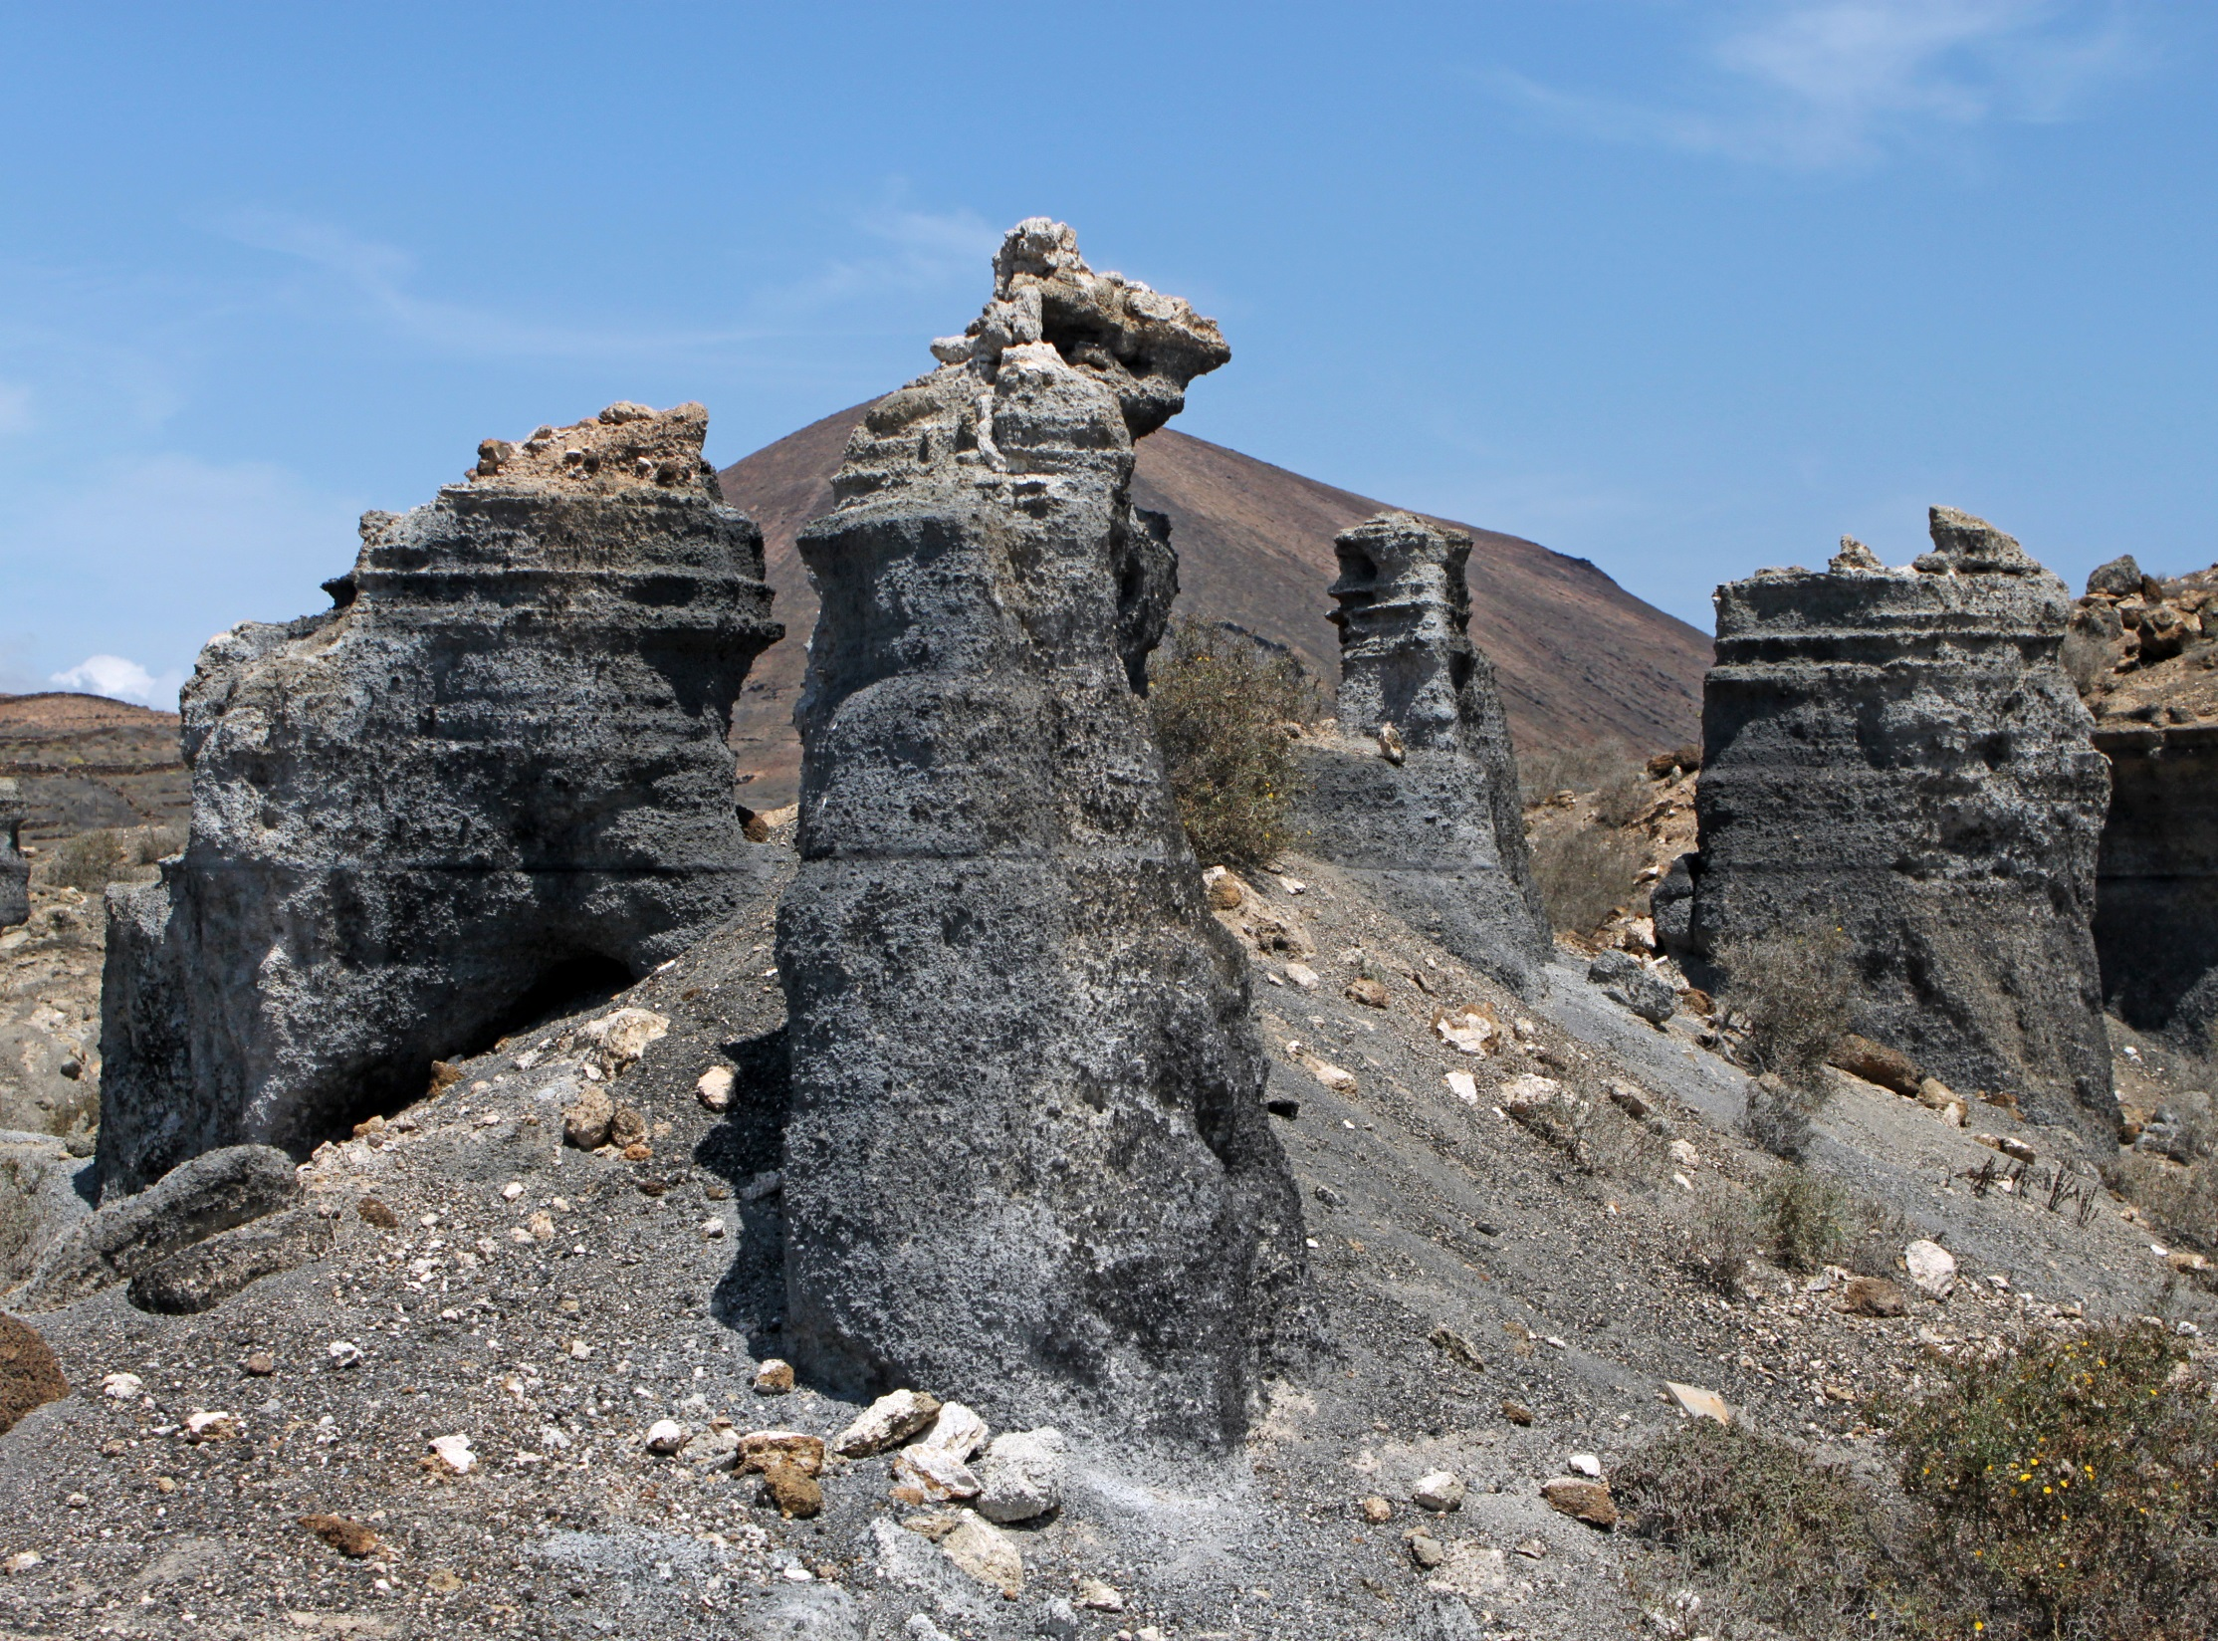
Notes:
http://commons.wikimedia.org/wiki/File:Erosion_of_Volcanic_Layers_Lanzarote_01.JPG
Erosion of volcanic layers, between Teseguite and Guatiza, Lanzarote, Canary Islands, Spain

Slide 6
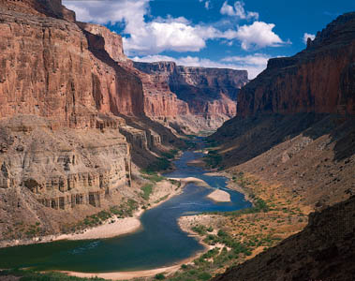
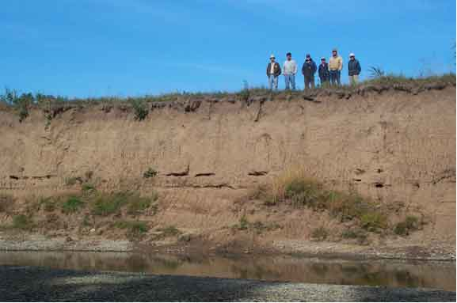
Notes:
http://www.maine.gov/dep/land/erosion/
http://kjpermaculture.blogspot.com/2008_01_01_archive.html
http://www.aegweb.org/students-educators/student-resources/aeg-for-students/geologic-hazards/erosion
The Grand Canyon is an impressive example of stream erosion through rock. For additional information on its formation visi

Slide 7
What do we know about erosion?
KWL or Graphic Organizer
Brainstorm

Slide 8
Model Erosion?
Materials
Observations
Soil-rock, sand, potting, mix Other?
Water
Pan
Data
Pictures Drawn/Ipad
Other?

Slide 9
Terminology
Science Benchmark
Other
Erosion
Erode
Sediment
Weathering
Buttes
Arches
Geological
Deposition
Delta

Slide 10
Model of Erosion Control
Materials
Observations
Popsicle sticks
Rocks
Moss
Plastic wrap
Other?
Data
Pictures Drawn/Ipad
Other?

Slide 11
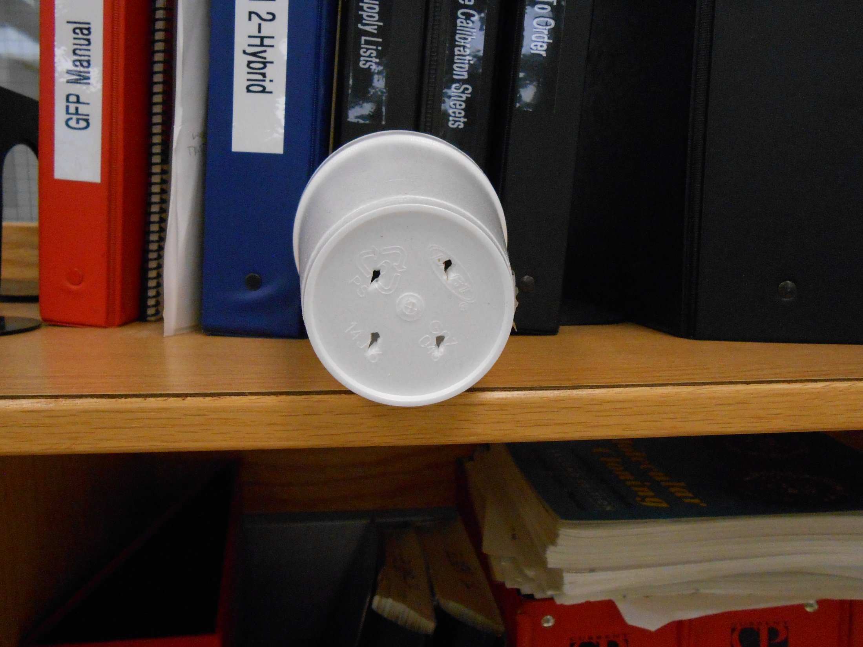

Slide 12
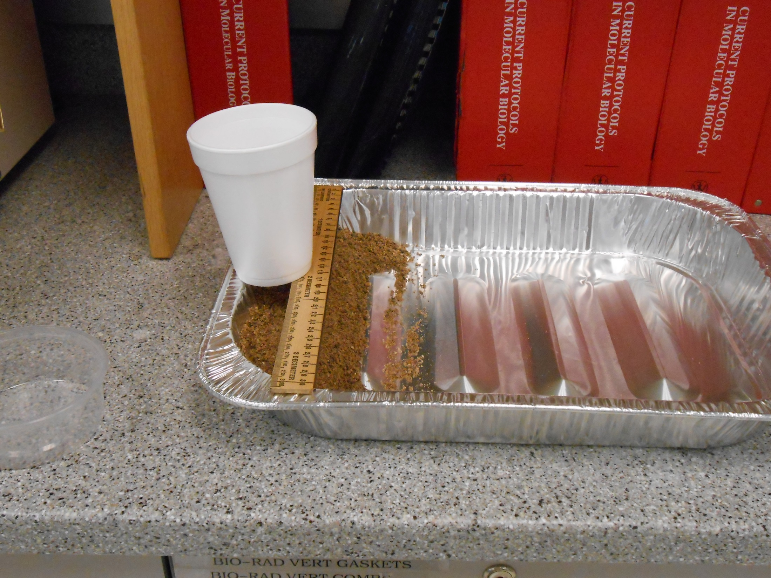

Slide 13
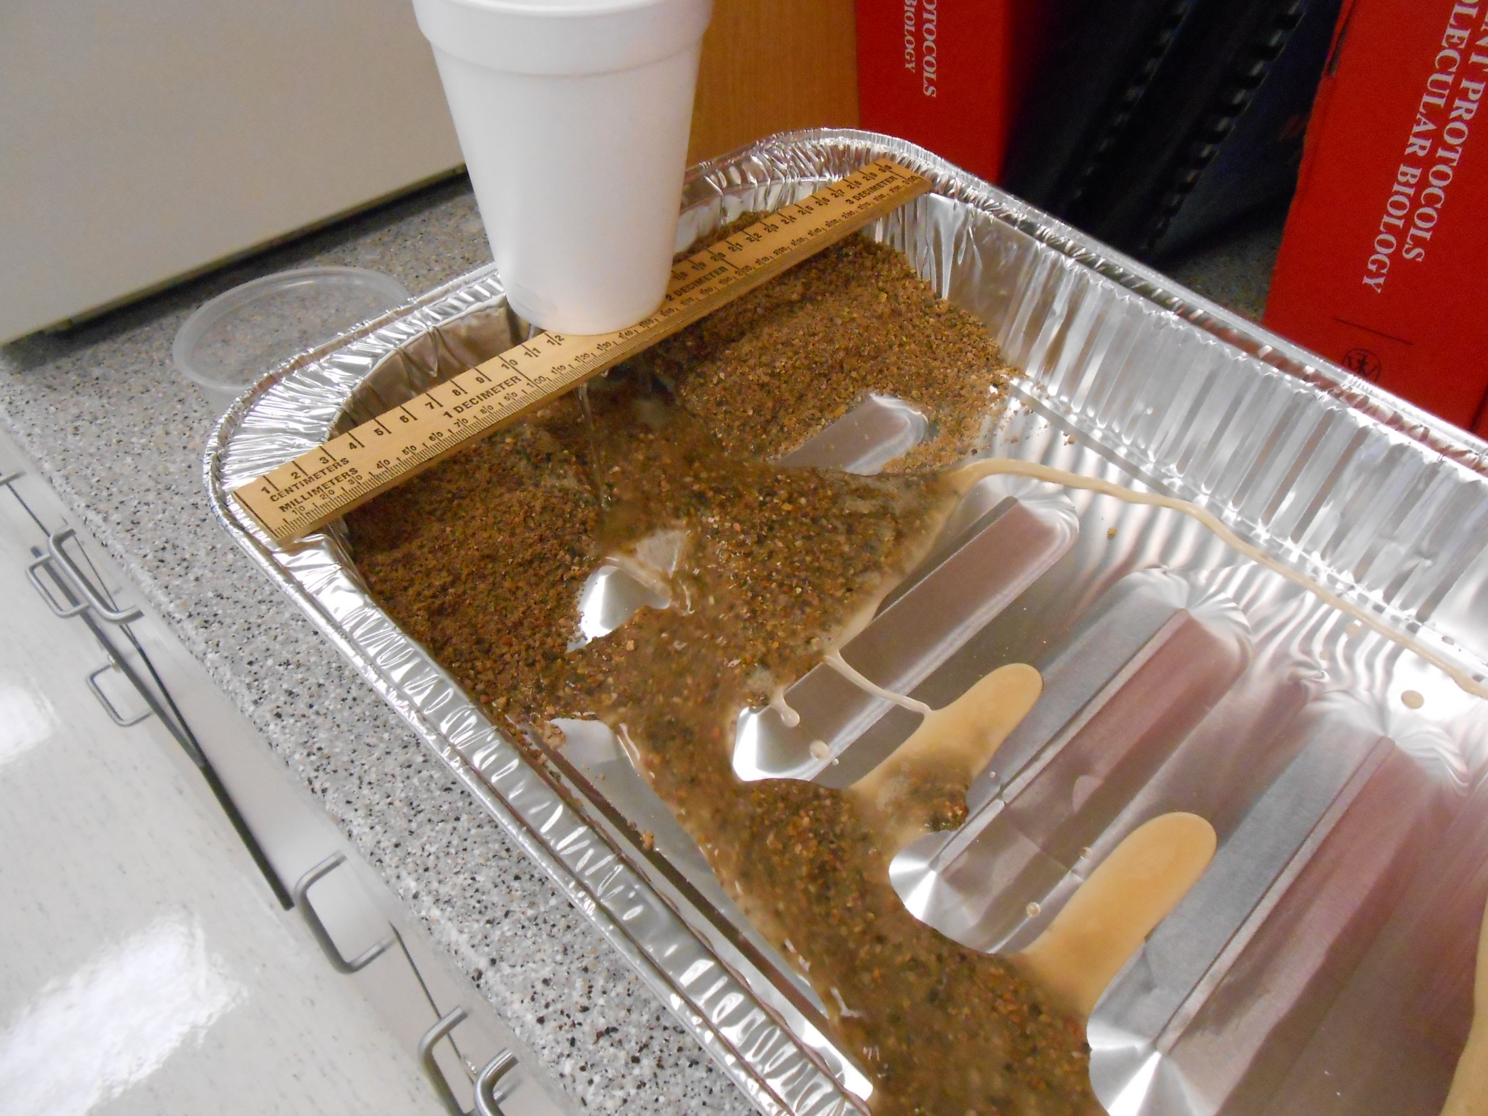

Slide 14
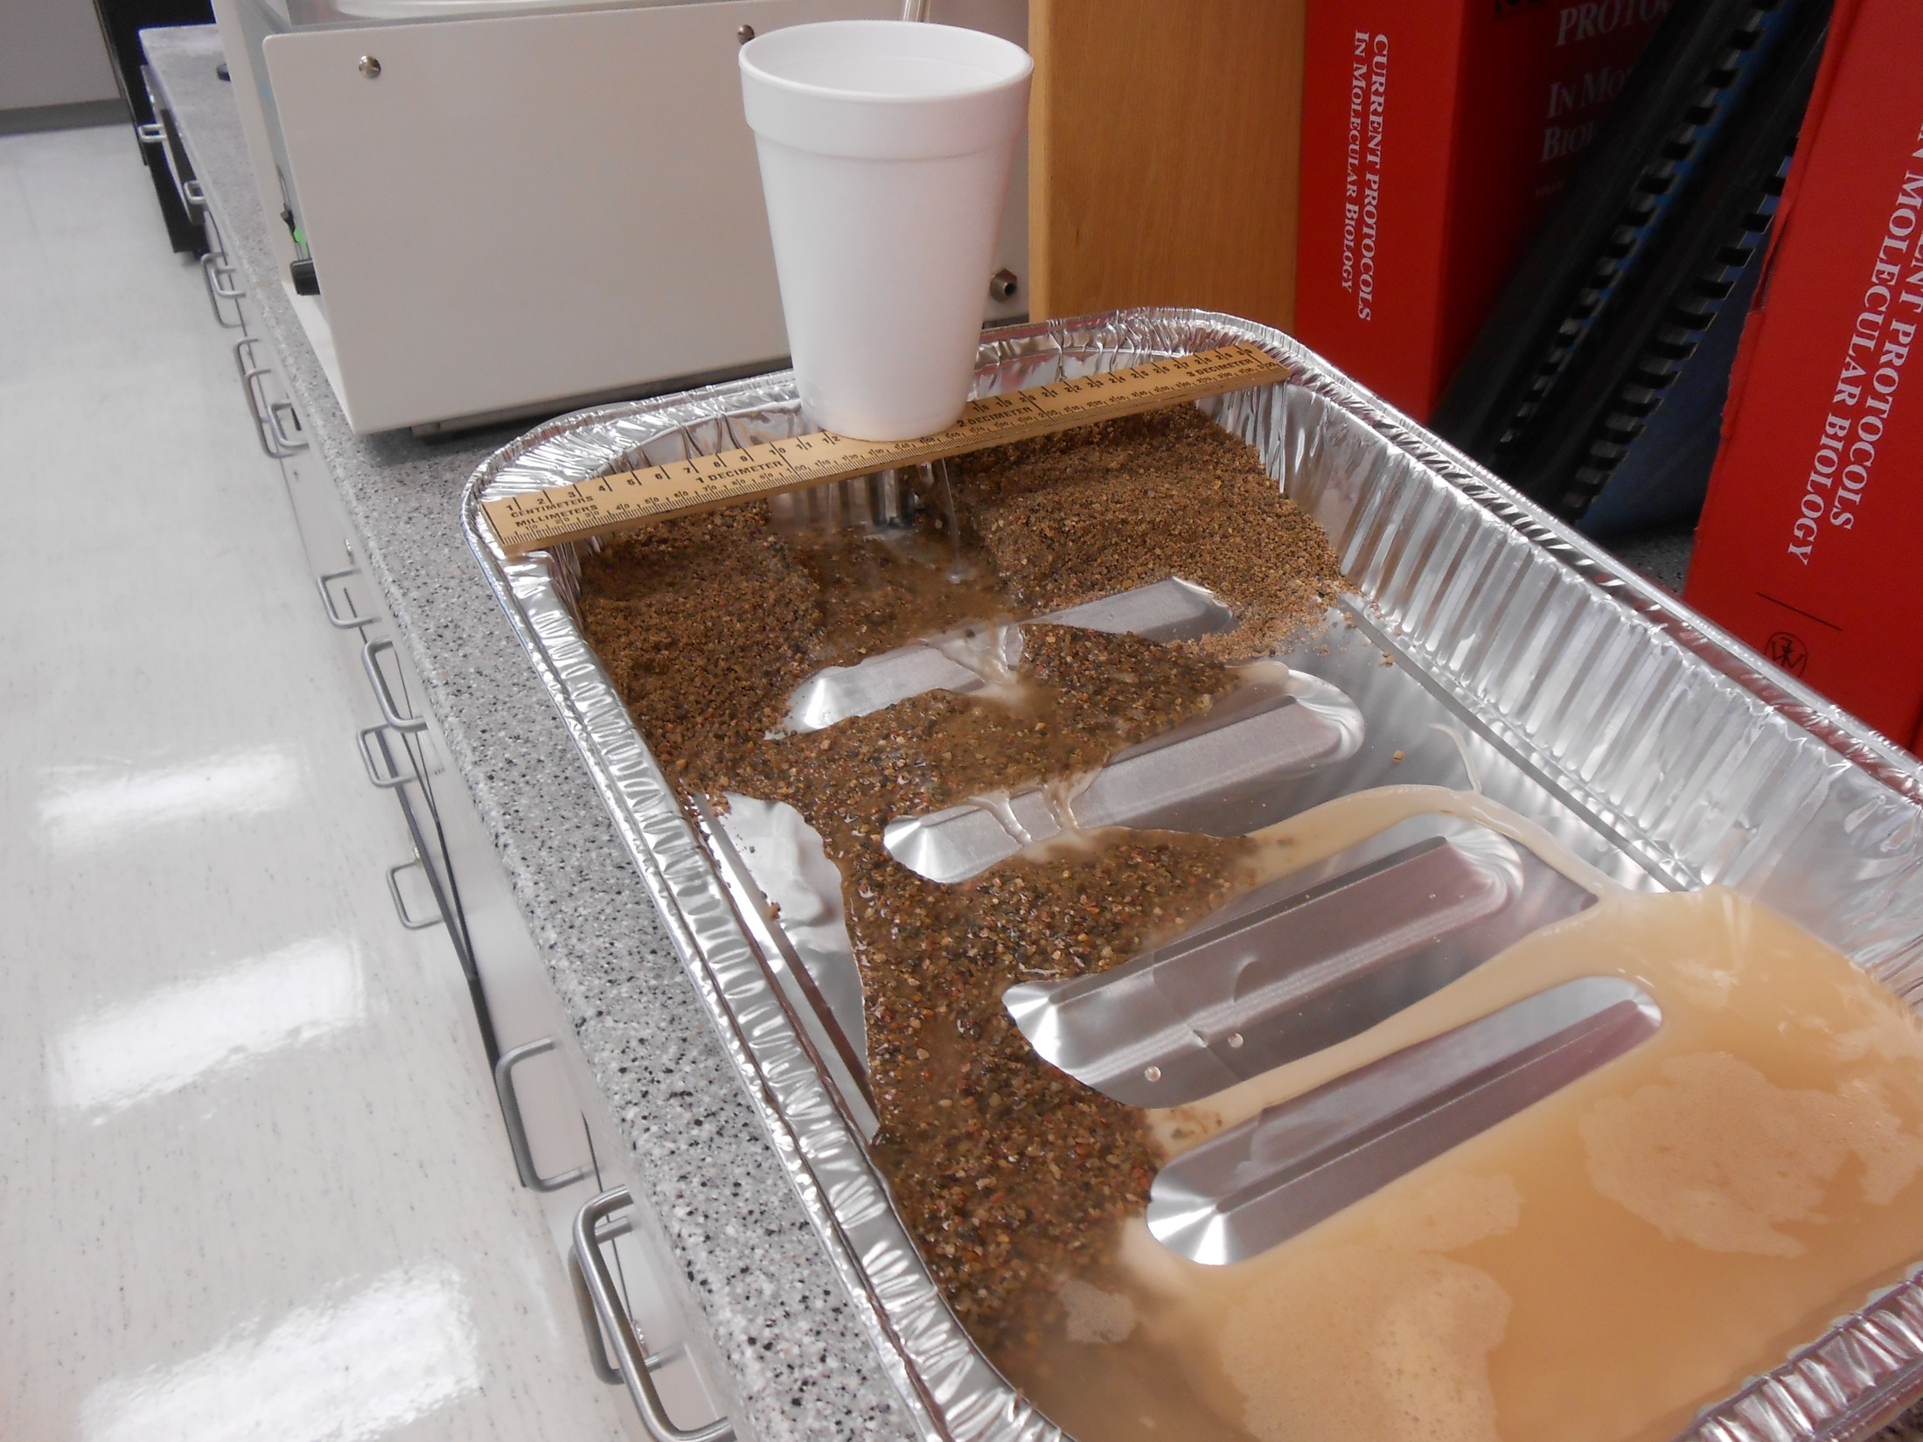

Slide 15
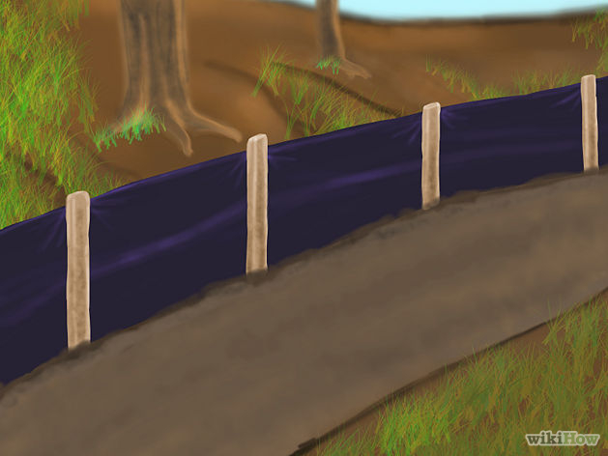
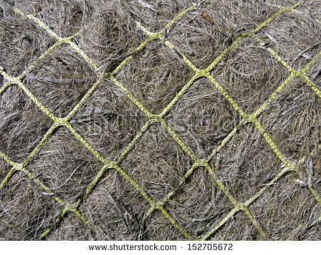
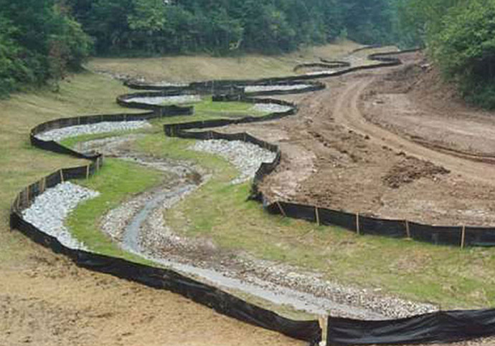
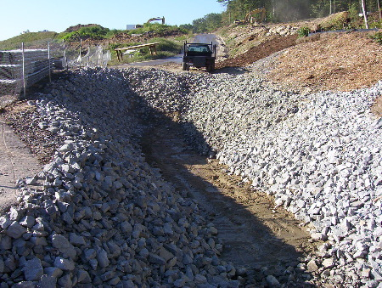
Notes:
http://www.wikihow.com/Image:Control-Erosion-Step-2.jpg
Greenish nylon mesh holding fibrous filler (recycled carpet waste fibers, perhaps) together in a roll to prevent erosion in park renovation : Ken Schulze
http://www.pm10inc.com/erosion-control.html
http://www.newsouthmat.com/soil-erosion-prevention-sediment-control/

Slide 16
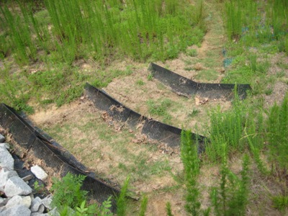
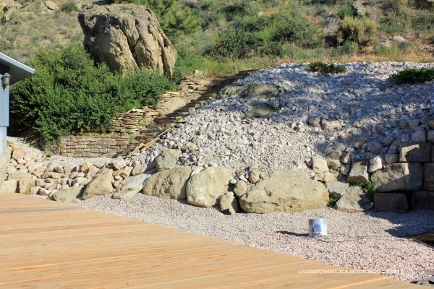
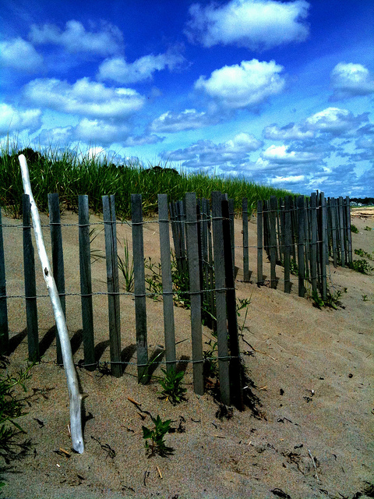
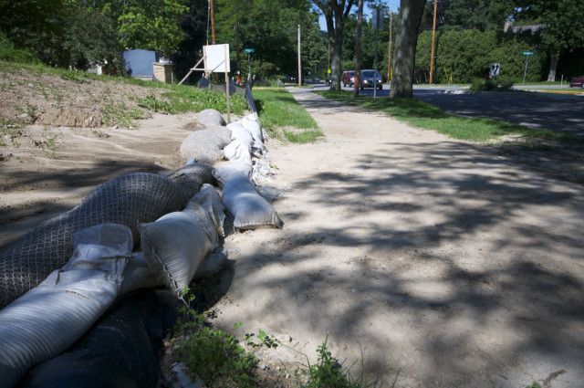
Notes:
http://www.wakegov.com/water/stormwater/erosion/Pages/default.aspx
http://wingrasprings.files.wordpress.com/2013/06/westminster-presbyterian-church-construction-site-erosion-24.jpg
http://ourhumbleabodeblog.files.wordpress.com/2013/07/back-deck-and-rock-around.jpg?w=600&h=400
http://farm5.staticflickr.com/4053/4719532945_023c378879_z.jpg

Slide 17
What do you know about erosion control?
KWL or Graphic Organizer
Picture to trigger conversation

