Slide 1
6th grade STEM
Standard III Solar System

Slide 2
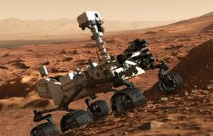
Lesson 1-The Story
6 minutes of terror

Slide 3
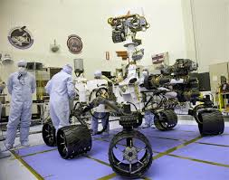
Lesson 2-Engineering
Nate Ball
Meet an Engineer

Slide 4
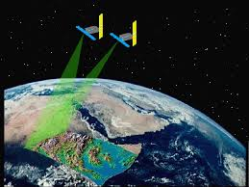
Lesson 3-What is the Science/Math/Technology I need to know?
Sending a message through space and receiving it.
How do we send a message through space?
How do we receive and translate it?

Slide 5
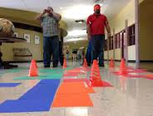
Lesson 4: The Engineering Challenge
Rover Races

