Slide 1
4th Grade Stem
November 12, 2013

Slide 2
Science Core
Science Standard 1:
Students will understand that water changes state as it moves through the water cycle.
• Objective 2: Describe the water cycle.
e. Describe how the water cycle relates to the water supply in your community.

Slide 3
Math Standards
Operations and Algebraic Thinking
2. Multiply or divide to solve word problems involving multiplicative comparison, e.g., by using drawings and equations with a symbol for the unknown number to represent the problem, distinguishing multiplicative comparison from additive comparison.
3. Solve multistep word problems posed with whole numbers and having whole-number answers using the four operations, including problems in which remainders must be interpreted. Represent these problems using equations with a letter standing for the unknown quantity. Assess the reasonableness of answers using mental computation and estimation strategies including rounding.

Slide 4
Math Standard
Measurement and Data
Solve problems involving measurement and conversion of measurements from a larger unit to a smaller unit.
1. Know relative sizes of measurement units within one system of units including km, m, cm; kg, g; lb, oz.; l, ml; hr, min, sec. Within a single system of measurement, express measurements in a larger unit in terms of a smaller unit. Record measurement equivalents in a two- column table. For example, know that 1 ft is 12 times as long as 1 in. Express the length of a 4 ft snake as 48 in. Generate a conversion table for feet and inches listing the number pairs (1, 12), (2, 24), (3, 36), ...
2. Use the four operations to solve word problems involving distances, intervals of time, liquid volumes, masses of objects, and money, including problems involving simple fractions or decimals, and problems that require expressing measurements given in a larger unit in terms of a smaller unit. Represent measurement quantities using diagrams such as number line diagrams that feature a measurement scale.

Slide 5
Social Studies
• Objective 3
Analyze how human actions modify the physical environment.
Describe how and why humans have changed the physical environment of Utah to meet their needs (e.g. reservoirs, irrigation, climate, transportation systemsand cities).

Slide 6
Language Arts
• RI.4.3 Explain events, procedures, ideas, or concepts in a historical, scientific, or technical text, including what happened and why, based on specific information in the text.
• W.4.2 Write informative/explanatory texts to examine a topic and convey ideas and information clearly.
• W.4.3 Write narratives to develop real or imagined experiences or events using effective technique, descriptive details, and clear event sequences
• W.4.2c Link ideas within categories of information using words and phrases (e.g., another, for example, also, because)

Slide 7
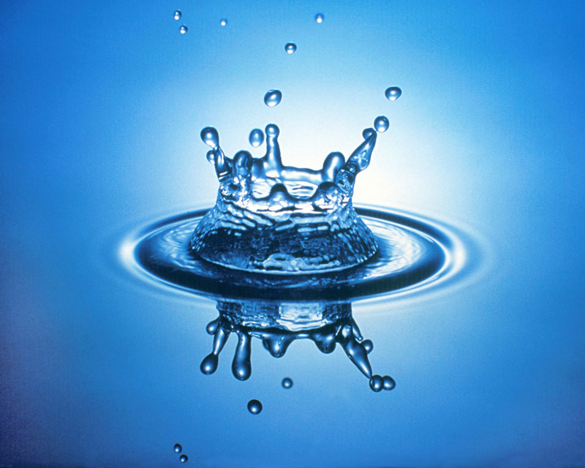
Pre-Assessment
Freshwater 101 quiz

Slide 8
The Water Cycle: What is It?
The Water Cycle: See it in action

Slide 9
A Drop in the Bucket
How much of the Earth’s water is fresh?
Freshwater: Why Care About Water?
Water is a limited natural resource.
-- unavailable
-- unequal distribution
-- pollution
Freshwater and how it is used

Slide 10
Math and Writing
How much water do you use?
- individually
- in a group
- as a class
How can I limit my water use?
Shared Reading and Writing
- What is a cycle?
- The Human Water Cycle

Slide 11
Water Outlook in Utah
http://www.epa.gov/watersense/our_water/tomorrow_beyond.html

Slide 12
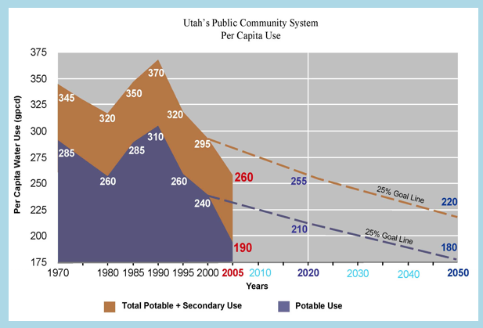
Water Use in Utah
http://www.conservewater.utah.gov/Blog/Blog.html

Slide 13
Images
http://earthobservatory.nasa.gov/IOTD/view.php?id=8132

Slide 14
Water Images
http://climate.nasa.gov/state_of_flux#Elephant_Butte_930x607.jpg

Slide 15
Water Projects
Conserve water – water use, engineer a product or system to limit water use (drip systems, faucet sensors, sprinkling systems, dishwasher or laundry systems, low flow toilets)
Preserve – keep water unpolluted, filter water, desalination of water
Harvest – collect rain water, tap water in wells and aquifers, store water in dams and reservoirs, desalination of water
Freshwater 101 quiz
Careers in Engineering

