Slide 1
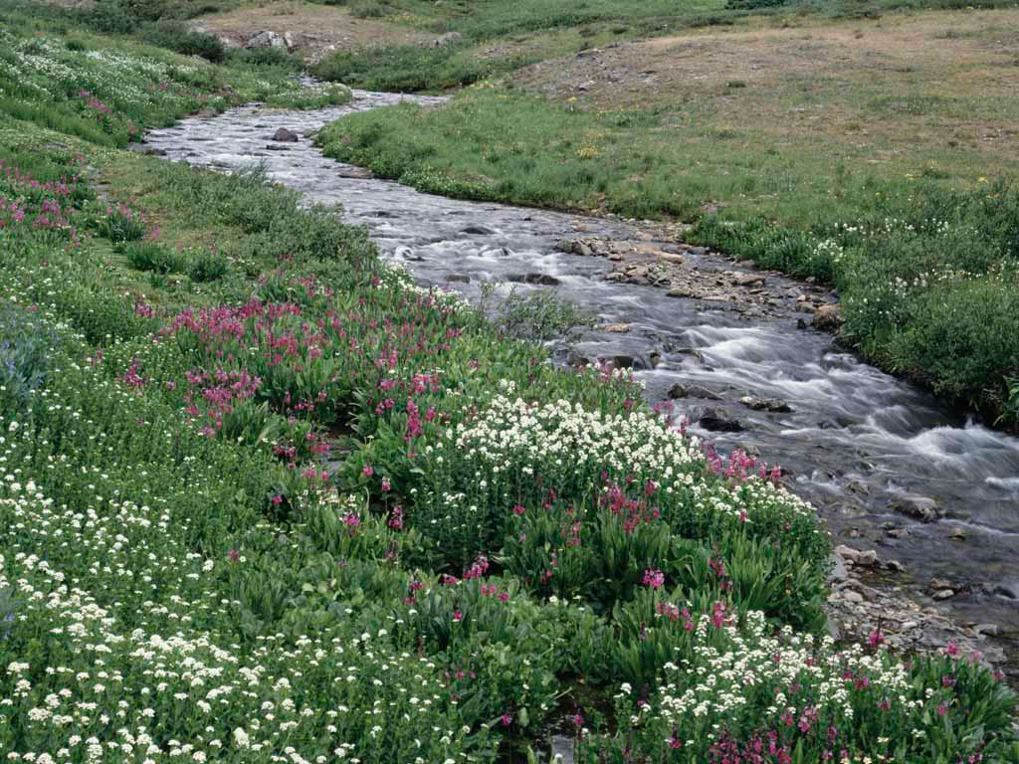
The Water Cycle

Slide 2
The Water Cycle
Condensation
Wind
Evaporation
Precipitation
Runoff
Collection
Review

Slide 3
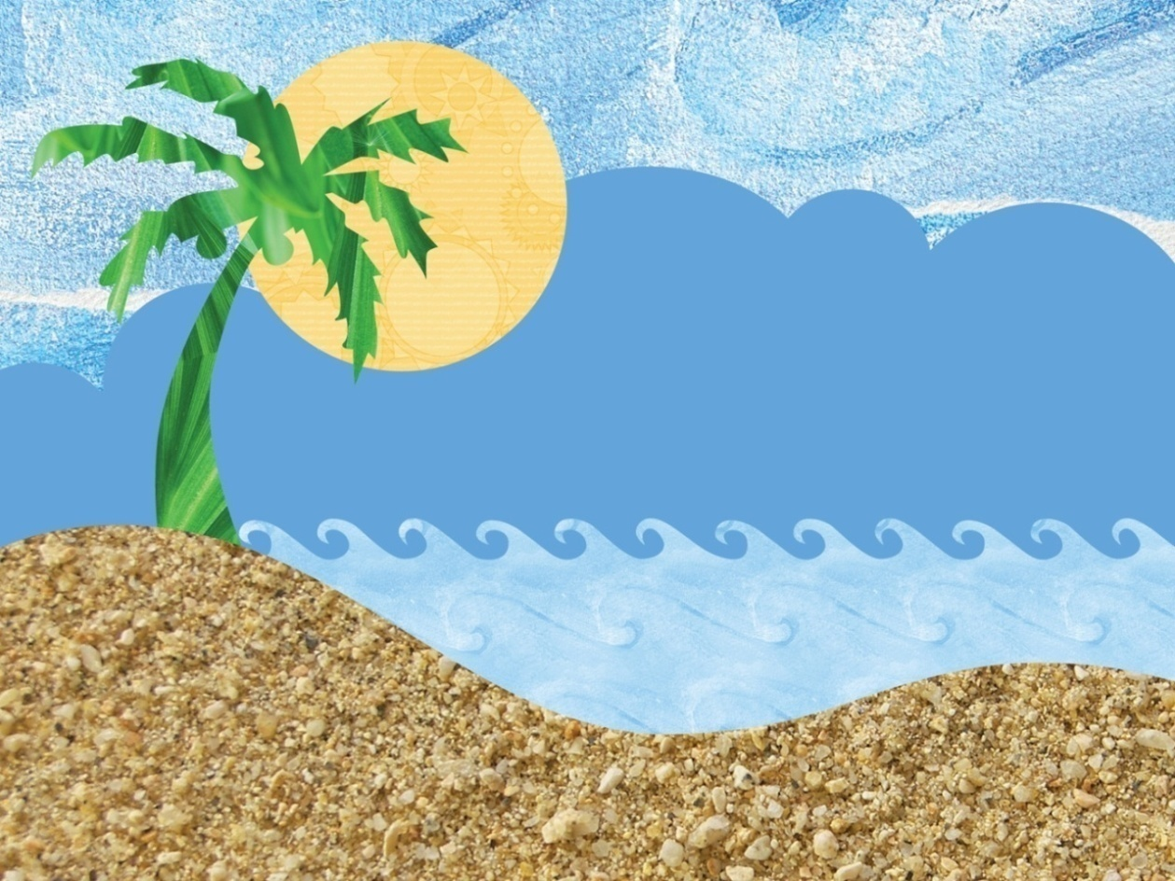
Evaporation
Sun shines on water
Water is heated
Water turns into vapor
Vapor enters the air
BACK

Slide 4
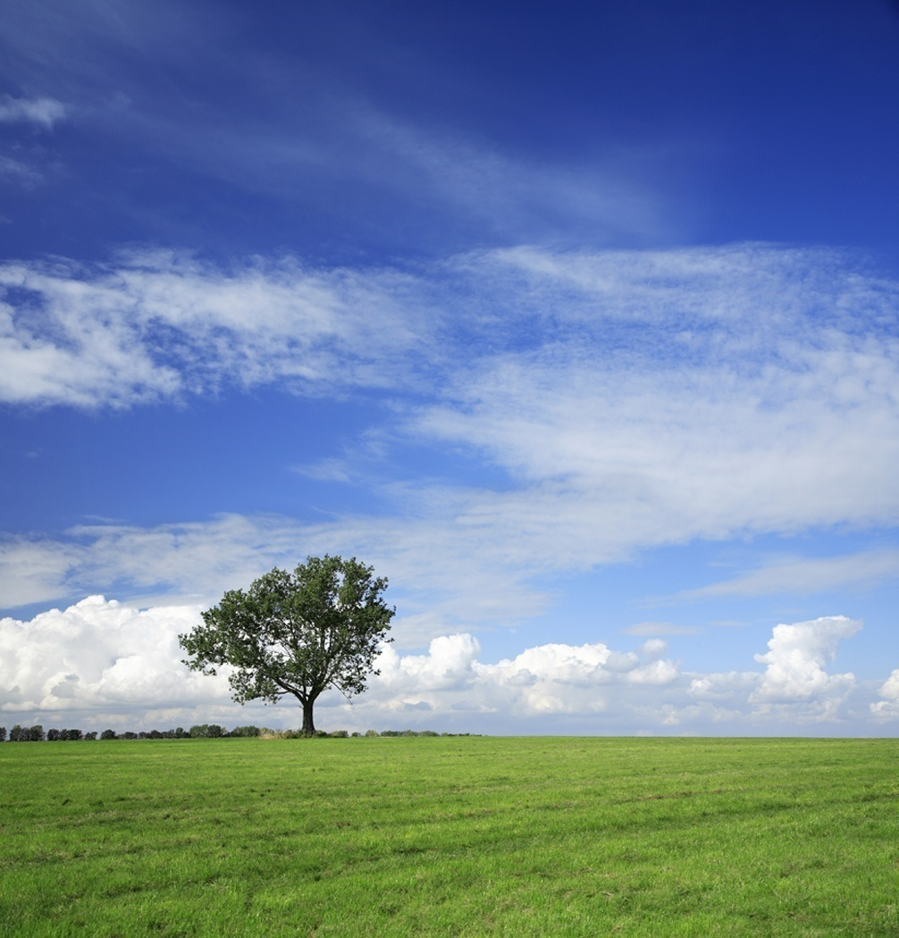
Condensation
Water vapor cools
Condenses into droplets
Droplets create clouds
BACK

Slide 5
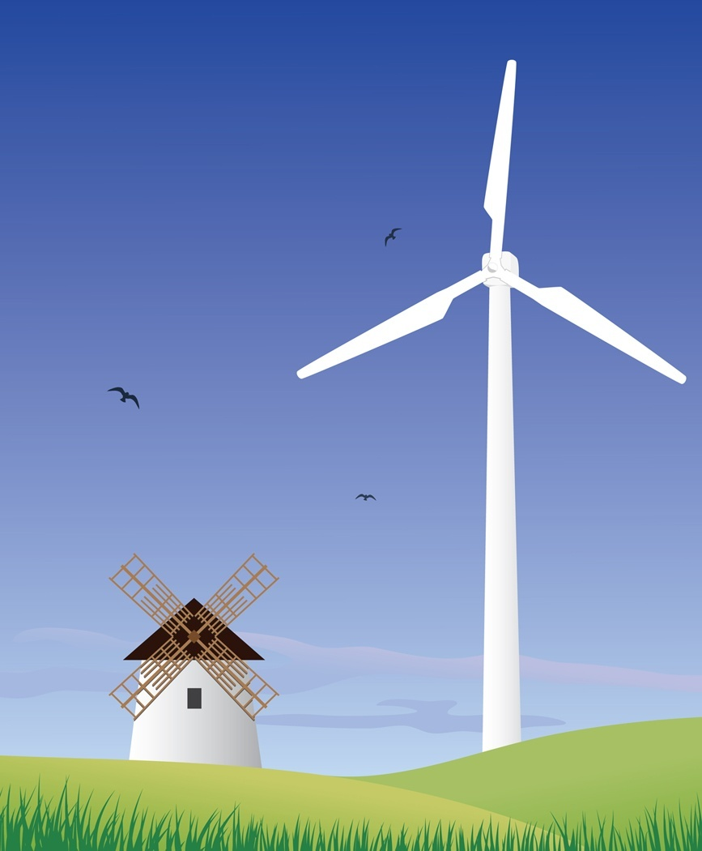
Wind
Wind moves clouds to
new places
BACK

Slide 6
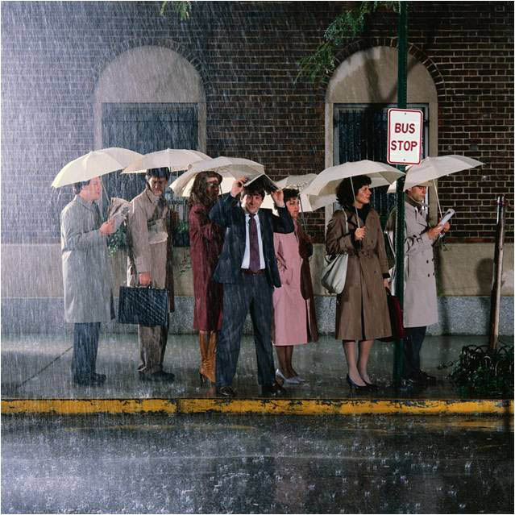
Precipitation
Air cannot hold more water
Water falls to the ground
Rain, snow, sleet, hail
BACK

Slide 7
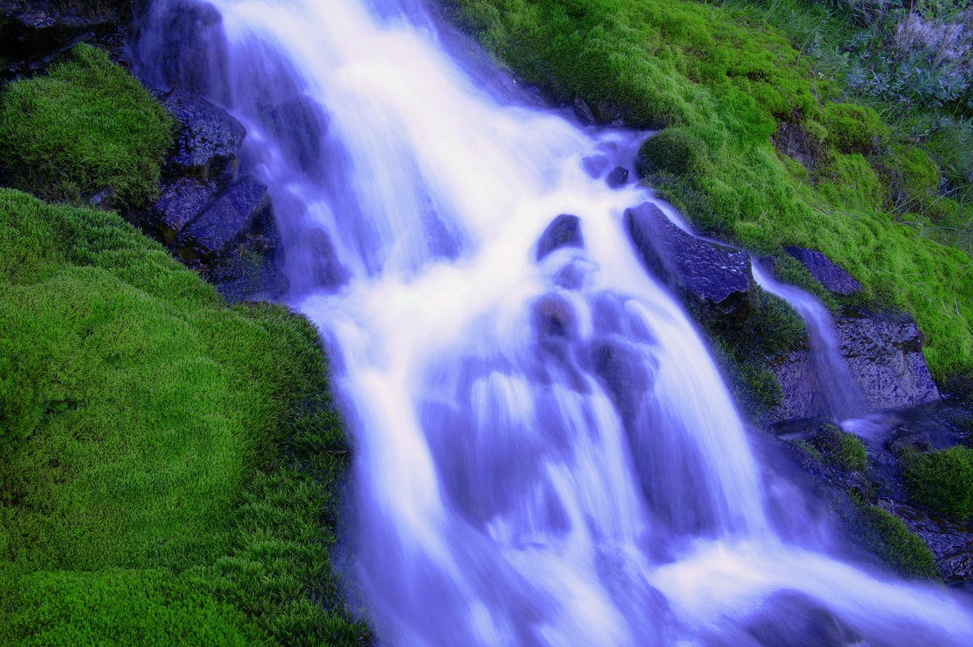
Runoff
Rain falls to ground
Runs downhill
Travels to new places
BACK

Slide 8
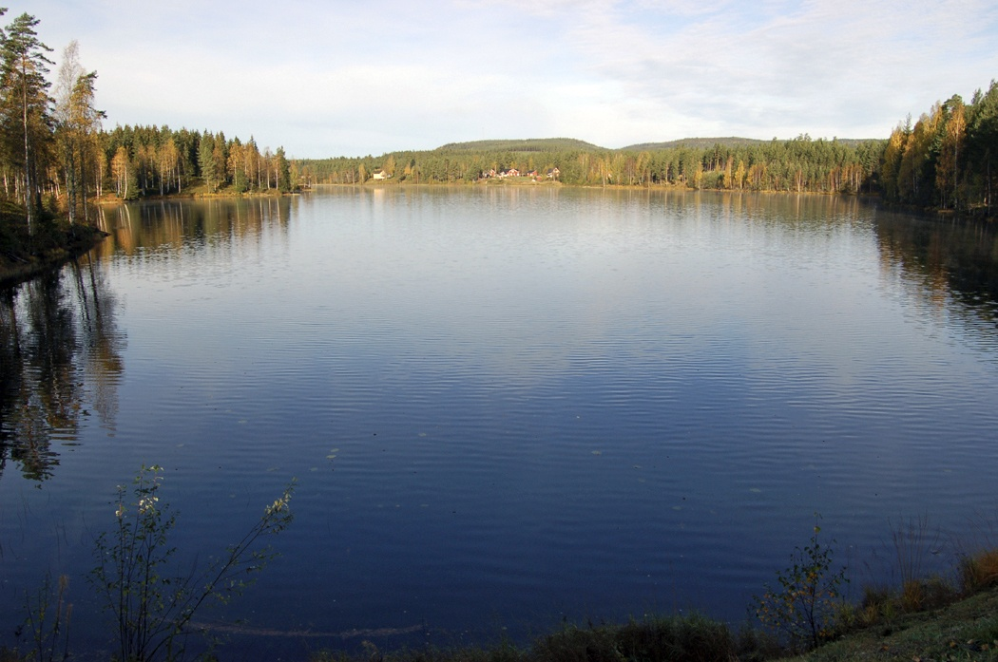
Collection
Collects
Lakes, rivers, oceans
Groundwater
BACK

Slide 9
Review
Evaporation
Condensation
Wind
Precipitation
Runoff
Collection
Return to the Water Cycle

